Slide 1
Simplifying Big Data USING Talend

Slide 2
Objectives
At the end of this session, you will be able to:
Understand how ETL is complementing Hadoop Ecosystem
Adapt to ETL-Big Data industry
Understand why Talend is used with Big Data
Learn Big Data not in months but in Minutes
Find out why Talend is important for Data Enthusiasts
Understand the Use Case – Banking Industry
Implement a Talend job with Hadoop

Slide 3

ETL with Big Data
A Graphical Abstraction Layer on top of Hadoop Applications – this makes life so much easy in the Big Data buzz world
The typical assertion is that "Hadoop eliminates the need for ETL”…. Seriously ?
What no one seems to question in response to these sorts of comments is the naive assumptions these statements are based on !!
Is it realistic for most companies to move all of their data into Hadoop?

Slide 4



ETL with Big Data
Extra and Load
Machine
Data
ETL
Transactional
Data
Big Data
Workflow
Business Apps
Data

Slide 5
ETL with Big Data (Contd.)
Is writing ETL scripts in MapReduce code still ETL?
Is ETL running faster (in few cases & slower in others) on Hadoop eliminating ETL?
Is introduction of Hadoop changing when, where and how ETL happens?
Yes
No
Yes
The question isn't really that are we eliminating ETL, but where does ETL take place & how are we changing its definition

Slide 6
Defining ETL
E
represents the ability to consistently and reliably extract data with high performance and minimal impact to the source system
T
L
stands for loading data into a persistent or virtual data store
represents the ability to transform one or more data sets in batch or real-time into a consumable format

Slide 7



Why ETL + Hadoop?
How learning ETL (along Big Data) is addressing major business problems ?
BIG DATA
DATA INTEGRATION
DATA QUALITY
MDM
ESB
BPM
TALEND UNIFIED PLATFORM
Notes:
Title and Content Slide – Font: Tahoma 12/14 (depending on the amount of text)
Heading: Calibri Heading 26 (consistent)
Bullet code – 174 for bullet
OOBB for sub bullet

Slide 8












One Stop Solution!!
An open source ecosystem
Improves efficiency of big data job design with graphic interface
Abstract and generates code
Run transforms inside Hadoop
Native support for HDFS, Sqoop, HBase, Mahout, Pig, Hive & MapReduce code generate
Apache License 2.0
Embedded in Hortonworks Data Platform
Certified with Cloudera, MapR and Grenplum
Notes:
Title and Content Slide – Font: Tahoma 12/14 (depending on the amount of text)
Heading: Calibri Heading 26 (consistent)
Bullet code – 174 for bullet
OOBB for sub bullet

Slide 9
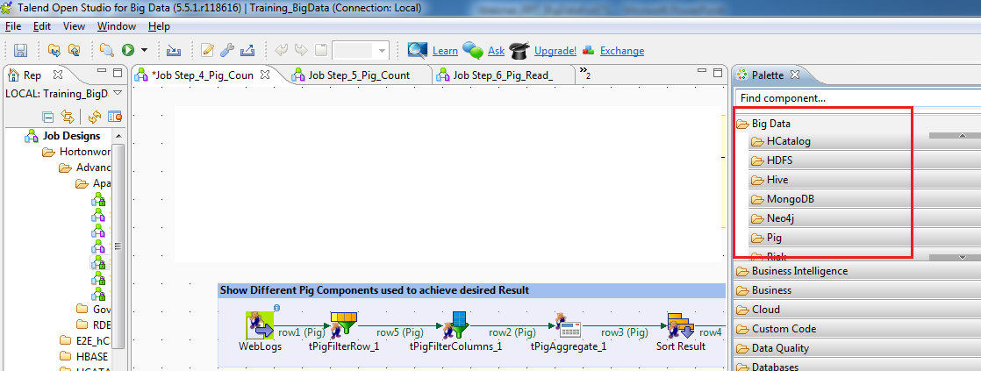
Talend
Q. Why Talend?
Ans . Because the more connected the world becomes, the more quickly a business must adapt

Slide 10
Why Talend?
Talend is the only Graphical User Interface tool which is capable enough to “translate” an ETL job to a MapReduce job. Thus, Talend ETL job gets executed as a MapReduce job on Hadoop and get the big data work done in minutes
This is a key innovation which helps to reduce entry barriers in Big Data technology and allows ETL job developers (beginners and advanced) to carry out Data Warehouse offloading to greater extent
With its Eclipse-based graphical workspace, Talend Open Studio for Big Data enables the developer and data scientist to leverage Hadoop loading and processing technologies like HDFS, HBase, Hive, and Pig without having to write Hadoop application code
Hadoop Applications, Seamlessly gets Integrated within minutes using Talend

Slide 11
Why Talend? (Contd.)
By simply selecting graphical components from a palette, arranging and configuring them, you can create Hadoop jobs
For example:
Load data into HDFS (Hadoop Distributed File System)
Use Hadoop Pig to transform data in HDFS
Load data into a Hadoop Hive based data warehouse
Perform ELT (extract, load, transform) aggregations in Hive
Leverage Sqoop to integrate relational databases and Hadoop

Slide 12


Talend Hadoop Integration
Notes:
Title and Content Slide – Font: Tahoma 12/14 (depending on the amount of text)
Heading: Calibri Heading 26 (consistent)
Bullet code – 174 for bullet
OOBB for sub bullet

Slide 13
Talend Hadoop Integration (Contd.)
For Hadoop applications to be truly accessible to your organization, they need to be smoothly integrated into your overall data flows
Talend Open Studio for Big Data is the ideal tool for integrating Hadoop applications into your broader data architecture
Talend provides more built-in connector components than any other data integration solution available, with more than 800+ connectors that make it easy to read from or write to any major file format, database, or packaged enterprise application
For Example, in Talend Open Studio for Big Data, you can use drag 'n drop configurable components to create data integration flows that move data from delimited log files into Hadoop Hive, perform operations in Hive, and extract data from Hive into a MySQL database (or Oracle, Sybase, SQL Server, and so on)
Notes:
Title and Content Slide – Font: Tahoma 12/14 (depending on the amount of text)
Heading: Calibri Heading 26 (consistent)
Bullet code – 174 for bullet
OOBB for sub bullet

Slide 14
Talend Hadoop Integration (Contd.)
More and more enterprise wanted to scale up in Hadoop/Big Data technologies with use of existing pool of talent and reduce overspending on map-reduce programmer (which is pretty new and expensive)
High rise of job trend in Data Scientist/Data Analysis (Talend also comes along with basic BI transformations which reduces your dependency on simple excel dash board/ BI tools)
Gartner is featuring Talend as the best technology in market for Data Integration and Big Data
3 major players in Big Data industry, Hortonworks, Cloudera, MapR have already tied up with Talend for big data solutions
And mostly any level person in industry can quickly get started on this without much pre-requisites
Myth : I don’t know Java programming , how would this course help me learn and excel in Big Data? The biggest advantage you get with Talend for Big Data is “there is no prerequisite” to learn this concept. Whether you come with prior knowledge of Hadoop or not , this course has some or other best things to offer
Notes:
Title and Content Slide – Font: Tahoma 12/14 (depending on the amount of text)
Heading: Calibri Heading 26 (consistent)
Bullet code – 174 for bullet
OOBB for sub bullet

Slide 15

Big Data in 10 minutes
Learn Big Data not in months but in Minutes!! Sounds too good ? But true
MAPR
HORTONWORKS
CLOUDERA
HADOOP
Go from zero to big data in under 10 minutes
Get big data without coding. The Talend Big Data Sandbox is a ready-to-run virtual environment that includes Talend Platform for Big Data, popular Hadoop distributions and data examples
Notes:
Title and Content Slide – Font: Tahoma 12/14 (depending on the amount of text)
Heading: Calibri Heading 26 (consistent)
Bullet code – 174 for bullet
OOBB for sub bullet

Slide 16
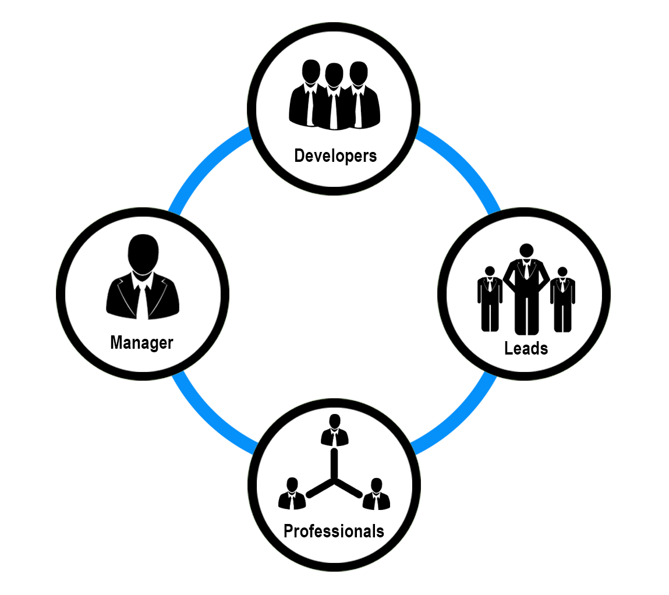
Who can use “Talend for Big Data”!!
Notes:
Title and Content Slide – Font: Tahoma 12/14 (depending on the amount of text)
Heading: Calibri Heading 26 (consistent)
Bullet code – 174 for bullet
OOBB for sub bullet

Slide 17

We are just about to see the Bigger Picture
Let us all see quickly, what Talend can do in minutes, reducing the man-hours in doing MapReduce programming in Hadoop, shall we?
Notes:
Title and Content Slide – Font: Tahoma 12/14 (depending on the amount of text)
Heading: Calibri Heading 26 (consistent)
Bullet code – 174 for bullet
OOBB for sub bullet

Slide 18
Real time Use Case : ETL + Big Data
In this section, you will be able to sense the true power of Talend+Big Data
A Banking industry use case :
“Addressing the challenges in growing the business with use of Big Data“ . We will use customer filled web-log data (collected by bank) and with the help of Pig-ETL job will answer the question “where should bank hold marketing campaigns for new product launch to get more business” , in ETL-Big Data Analytics style

Slide 19

Project
Use Case
A Leading bank has initiated a new product launch campaign across the cities.
Post campaign , the bank wants to analyze the collected data to increase Business and attract more customer.
How quickly can the huge log files will be analysed and made some business value out of it within seconds ?
Wanted to know , explore the “Talend for Big Data” and join us in the next exciting webinar and see how beautifully talend does the trick without any complex programming (because seeing is believing).
If that is not all enough , the same talend can generate graphical interpretation of the business data giving tough time to Business Analytics tools.
Notes:
Project Details

Slide 20
Environment Setup
Our use case setup is using the below :
Hortonworks Sandbox 1.3
Talend Open Studio for Big Data 5.5
Windows 7 (64 Bit OS)
Machine : 4GB RAM , i3 processor
Notes:
Title and Content Slide – Font: Tahoma 12/14 (depending on the amount of text)
Heading: Calibri Heading 26 (consistent)
Bullet code – 174 for bullet
OOBB for sub bullet

Slide 21
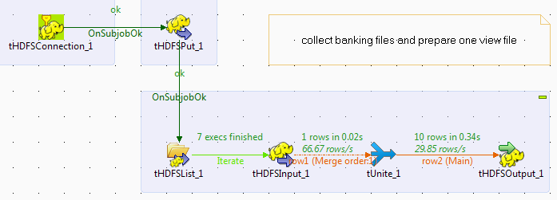
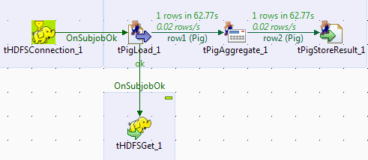
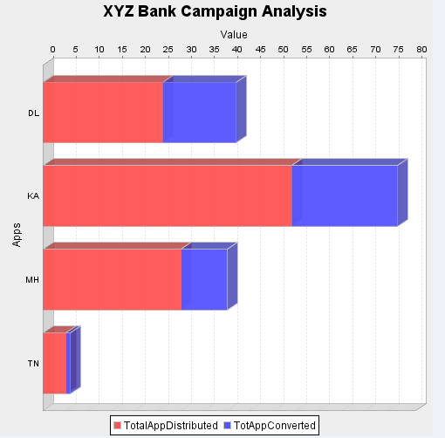
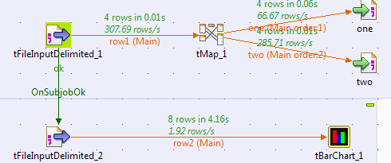
Use-case Snapshot
Combination of Integration , HDFS , Pig and BI Graphs … yes its true.
Notes:
Title and Content Slide – Font: Tahoma 12/14 (depending on the amount of text)
Heading: Calibri Heading 26 (consistent)
Bullet code – 174 for bullet
OOBB for sub bullet

Slide 22
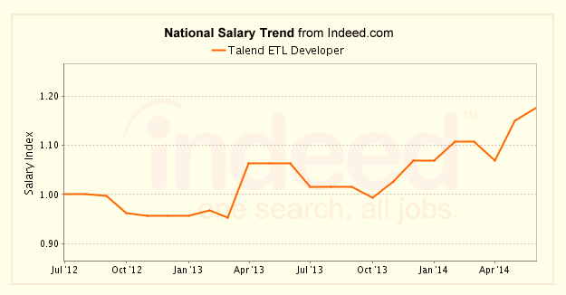
Salary Trend

Slide 23
References
https://www.talend.com/resource/hadoop-applications.html
http://www.edureka.co/blog/big-data-and-etl-are-family/

